Slide 1
Economic Growth and Society

Slide 2
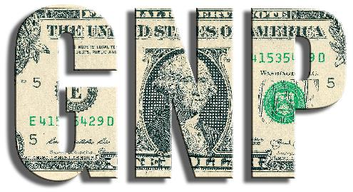
GDP and GNP
Gross Domestic Product (GDP)
The total value of all goods and services produced in a country in any one year is referred to as the gross domestic product (GDP).
This includes both Irish and foreign-owned companies and individuals located or resident in Ireland.
Gross National Product (GNP)
Gross national product (GNP) represents the total value of all goods and services produced by Irish companies or individuals both in Ireland and abroad.
The activities of foreign-owned companies operating in Ireland are not included in GNP.

Slide 3

Calculating Economic Growth

Slide 4
Benefits of Positive Economic Growth to Your Area
Economic growth in the country can bring benefits to your county, town or village:
New business start-ups will reduce unemployment.
Incomes rise, so people enjoy a higher standard of living and have more to spend on social activities in the area.
The government has more money to spend on health and education. Local authorities have more money to spend on local amenities.
Young people will not feel the need to emigrate.

Slide 5
Achieving Positive Economic Growth
Certain conditions must exist for a country to experience positive economic growth:
Inflation (a general rise in prices) is kept low so that people are encouraged to buy more goods and services.
Interest rates are low so that people will borrow money to start new businesses.
Wage increases and other costs are kept low so that businesses can grow.
The government budgets well and reduces the amount they have to borrow, leaving them with more money to spend on improving services such as health, education and transport.

Slide 6
The Economic Cycle
Economic Boom
An economic boom describes a period of substantial economic growth in an economy over a period of time. During a boom period:
Wage levels rise, giving consumers more discretionary income and increasing the standard of living.
Production increases to meet increased demand from consumers.
Prices increase, leading to a rise in the rate of inflation as employers deal with higher wage demands.

Slide 7
The Economic Cycle
Recession
A recession describes a period where economic activity has dropped considerably over a number of months. During a recession:
There is a slowdown in production.
Employment levels fall, as workers are made redundant or put on short time.
Demand falls as people see a decline in their income.
Government income falls, which leads to a reduction in spending on essential services.
Some firms experience difficulty and close. There are fewer new business start-ups.
There is low inflation, as prices remain the same or fall.

Slide 8
The Economic Cycle
Depression or Slump
A depression describes a recession that lasts for a considerable time and results in a long-term reduction in the level of production of goods and services in a country – in other words, there is a reduction in economic activity. The signs of a depression are:
Increasing unemployment
Fall in demand for goods and services
Reduced consumer spending as consumers choose to save in case their personal circumstances disimprove
Inflation remains low

Slide 9
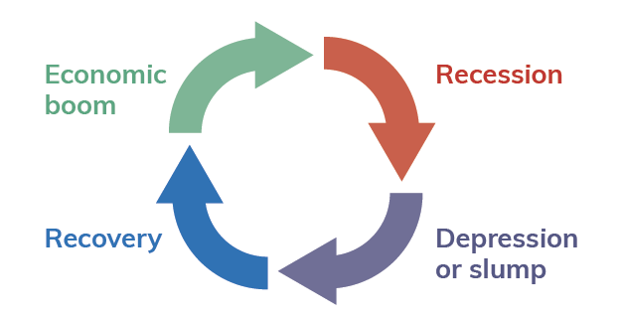
The Economic Cycle
Recovery
An economy usually goes into recovery after a recession or depression. It is marked by:
An increase in consumer spending
Increased production in response to increased consumer demand
Falling unemployment
Inflation and interest rates stop falling but remain low

Slide 10
Impact of Economic Growth on Society
Positive Impacts
Economic growth leads to increased employment, as firms need to hire more staff.
Government income increases due to increased employment and reduced social protection payments, which means more money is available for spending.
Foreign inward investment increases, as large multinationals see Ireland as a good place to do business and with a ready supply of skilled labour.
There is an increase in entrepreneurial activity.
Fewer Irish people and families are living in poverty.
The health and education of the population improve, as more people can afford to eat well and look after their health and to invest in education to improve their skills.

Slide 11
Impact of Economic Growth on Society
Negative Impacts
Economic growth can result in a widening of the gap between rich and poor.
Output and employment in agriculture has fallen dramatically. As a result, many small farms have closed and others are struggling to survive as they cannot compete against the large food companies supplying food products at much lower costs.
While economic growth can lead to improved health and a longer life, an ageing population can put a strain on the economy as more and more people rely on state pensions and access to the health service.
Increased emphasis on work and meeting targets may result in less family and social time, which can negatively affect wellbeing.

Slide 12
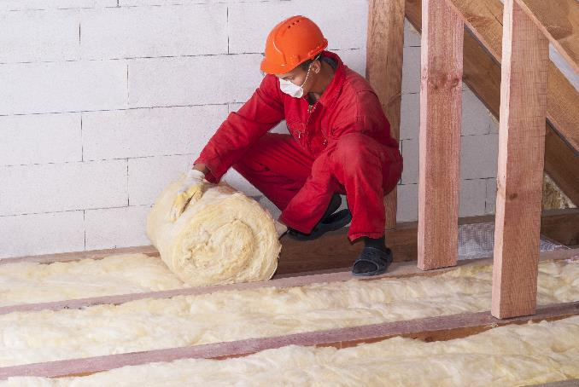
Impact of Economic Growth on the Environment
Positive Impacts
Increased finance for the government, which they could spend on promoting sustainability and taking measures to meet their climate change commitments.
As the revenue and profitability of companies increases, they will have more money available to spend on pollution control systems and for investment in cleaner and more efficient technologies.
Households will have more income available to spend on insulation, energy efficiency and hybrid cars.
The government will have more money available to give grants to both businesses and households to become more environmentally friendly and to conserve energy.

Slide 13
Impact of Economic Growth on the Environment
Negative Impacts
An increase in the use of natural resources such as land, water and air, which further depletes these resources.
An increase in pollution from both factories and increased traffic congestion, which negatively affects the environment and people’s health.
Increased production, which further affects climate change, thereby increasing the risk of extreme weather conditions such as flooding, heat waves, droughts and storms.
Increased construction of roads, factories and housing. This inevitably leads to a reduction in green space and the destruction of natural wildlife habitats.
Increased production and consumption, which in turn leads to increased waste. This waste has to be disposed of, which can put pressure on landfill sites and lead to increased use of incineration as a means of controlling waste.

Slide 14
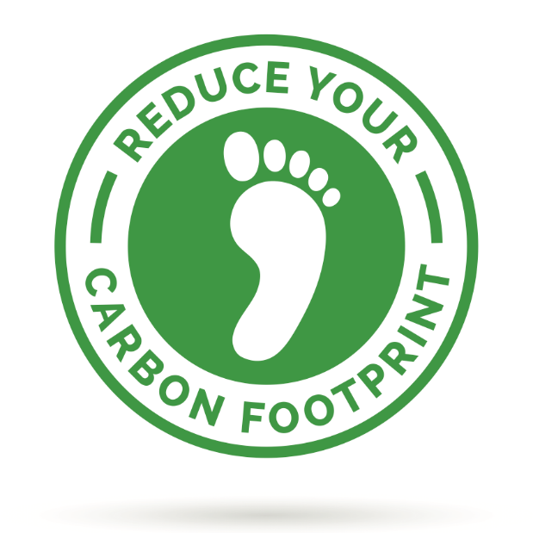
Carbon Footprint
Measuring the amount of carbon dioxide released into the atmosphere as a result of the activities of a particular individual, a country (for example, Ireland) or an organisation (for example, an airline) is known as measuring your carbon footprint.
Reducing your carbon footprint will result in less carbon dioxide in the atmosphere and a reduction in global warming. You can calculate your carbon footprint on the Carbonfootprint.com website.

Slide 15
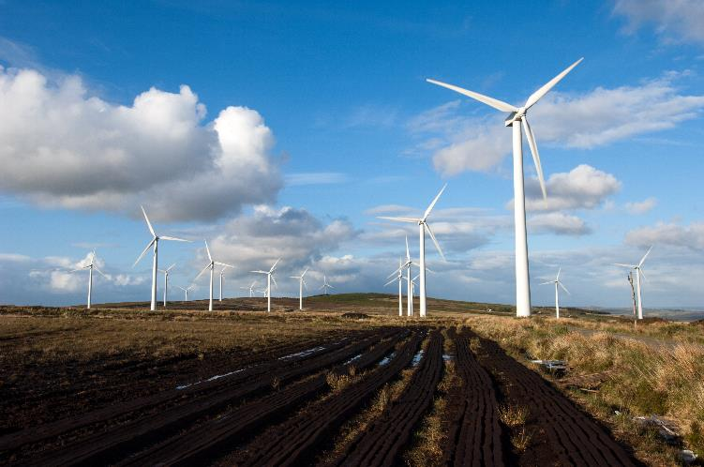
Sustainable Development and Government Policy
Under international agreements and EU regulations, the government is required to pass laws aimed at protecting the environment and helping Ireland to reach its environmental targets.
To achieve these aims, Ireland has introduced legislation such as:
The Waste Management Act, 1996
The Protection of the Environment Act, 2003
The Climate Action and Low Carbon Development Act, 2015

Slide 16
Sustainable Development and Government Policy
The Environmental Protection Agency (EPA) was established in 1992 to ensure that Ireland’s environment is protected and to monitor any dangerous changes in environmental trends.
The main functions of the EPA are to:
Enforce environmental law
Provide education and guidance on environmental issues
Regulate Ireland’s greenhouse gas emissions
Carry out environmental research and development
Develop and implement waste management policies

Slide 17
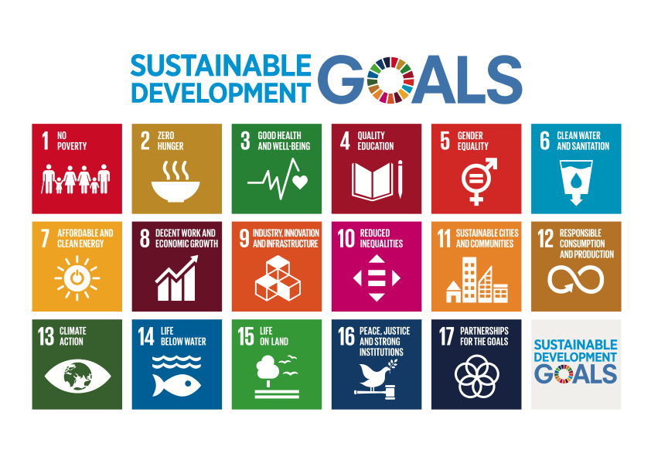
Global Sustainable Development

